Slide 1
EZParking
Mock Up

Slide 2
Detailed Page Information

Slide 3
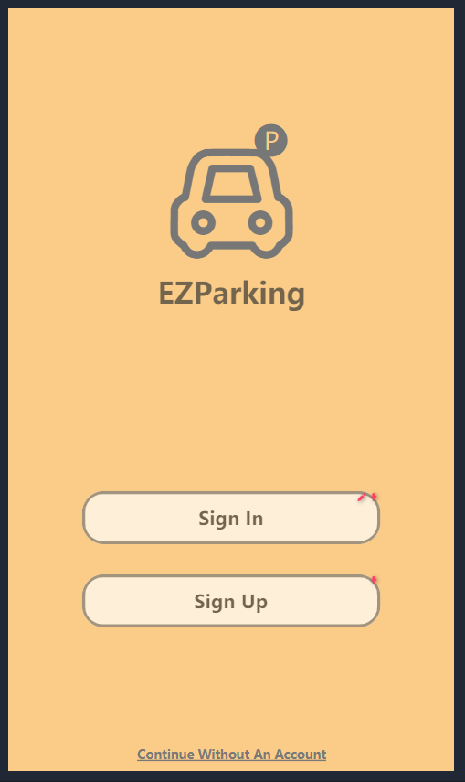
Home page
Press to direct to Sign In page
Press to direct to Sign Up page
Press to direct to check Singapore carparks & availability
Allow user using the app anonymously

Slide 4
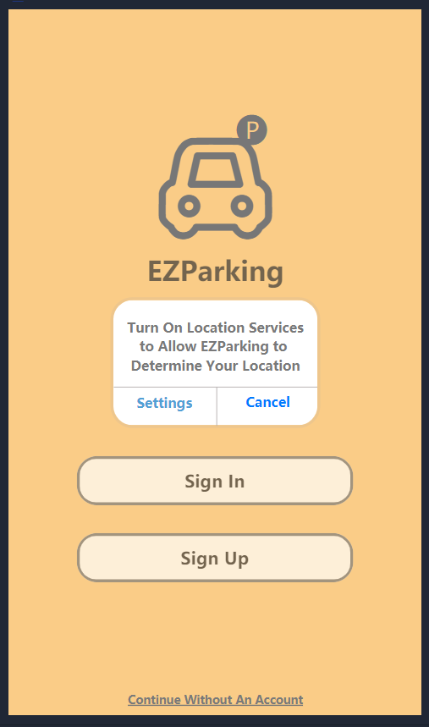
Location Access - Home
Press to direct to the phone setting and enable location access
Press to reject location access and remain in the current Home page

Slide 5
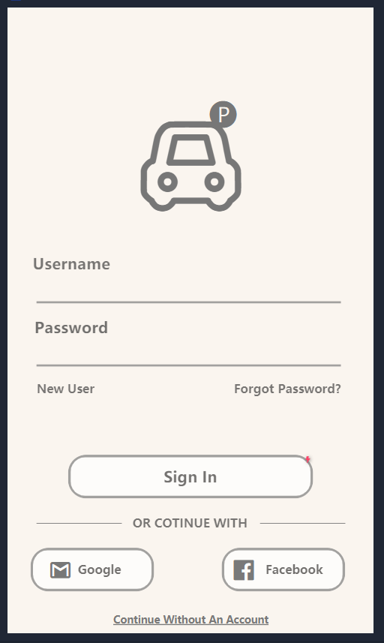
Sign In page
Enter existing account’s username & password to login
Press to direct to Sign Up page for new account registration
Press to direct to browser installed on the phone for password retrieval
Press to direct to Login In
Press to direct to Facebook for verification request
Press to direct to google applications installed on the phone such as Chrome or Gmail
Allow user using the app anonymously

Slide 6
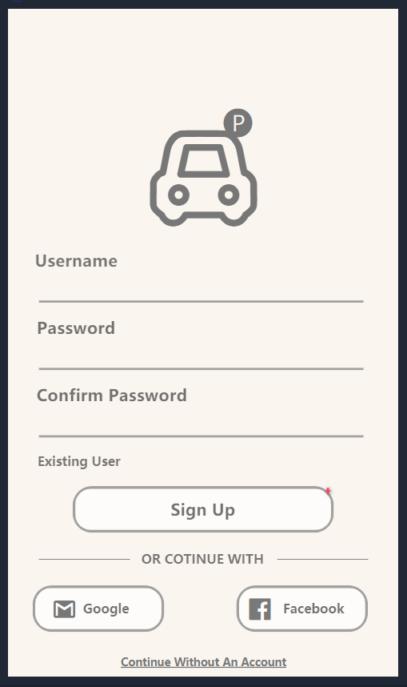
Sign Up page
Input username (email address) and password for new account registration
Confirm password input
Press to return to Sign In page
Press to register new account and login to the app
Press to direct to google applications installed on the phone such as Chrome or Gmail
Press to direct to Facebook for verification request

Slide 7
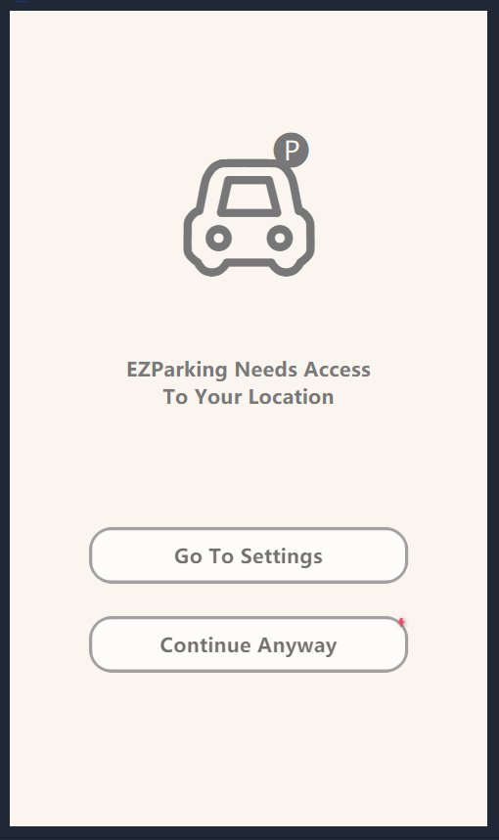
Location Access - After Sign In
Press to direct to the phone setting and enable location access
Press to continue using the app without location access

Slide 8
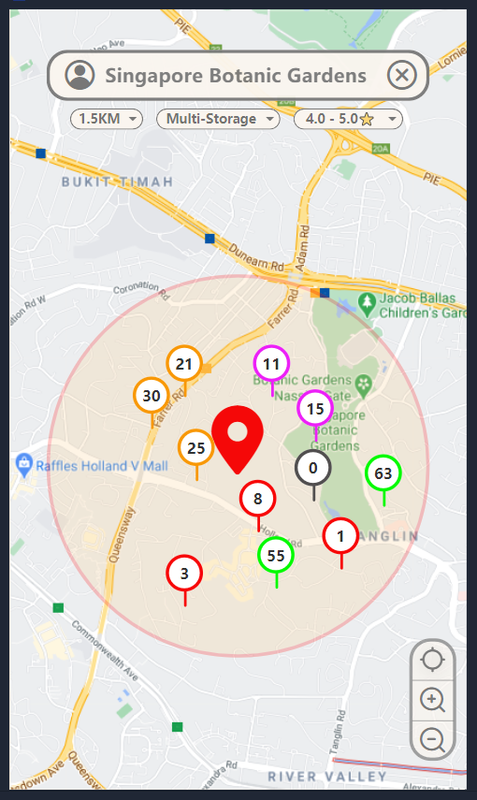
Current Location & Nearby Carpark
Change the current location to another one
Showing nearby carpark within selected range
Address of current location
Select carpark type
Filter carparks based on the selected rating
Carparks within the selected range
Number of available parking lots: - Grey: 0 - Red: 1 to 10
- Purple: 11 to 20
- Orange: 21 to 30
- Green: 31 and above
User’s current location
Relocate to current location
Zoom in
Zoom out

Slide 9
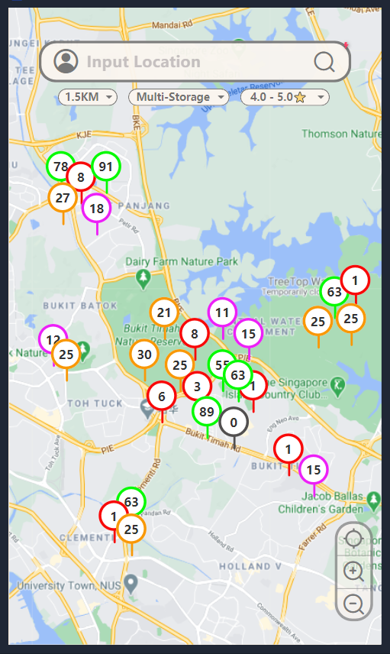
Singapore Carparks & Availability
Press to sign out or sign in
If user’s current location is not detected, the application will display all the number of available parking lots for carparks across the whole Singapore
Relocate to current location
Zoom in
Zoom out

Slide 10
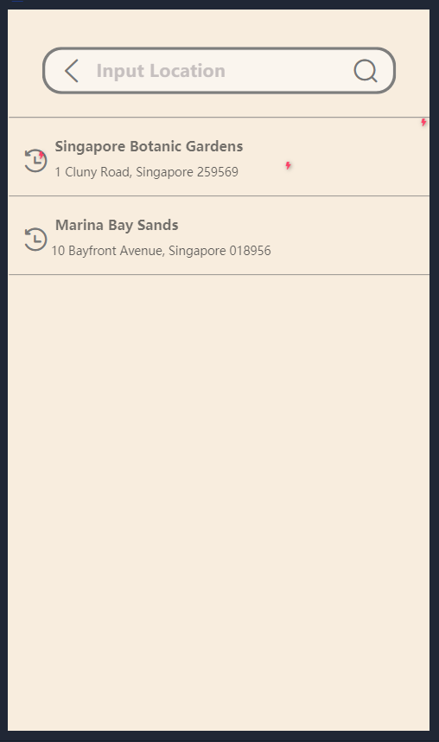
Search Location
Return to previous page
Press to select the recent search location
User can manually search location by entering full address name or postal code to check out the nearby parking lot vacancies.

Slide 11
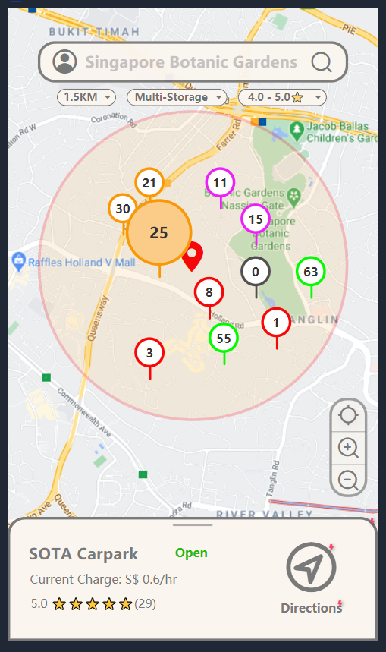
Selected Carpark
Press to sign out or sign in
Selected carpark will be magnified
Pull up to view the detailed information of the selected carpark
Display carpark information:
- Carpark Name
- Current carpark status
- Current Parking Charge
- Ratings of the selected carpark
Press to navigate the path to the selected carpark via Google Map

Slide 12
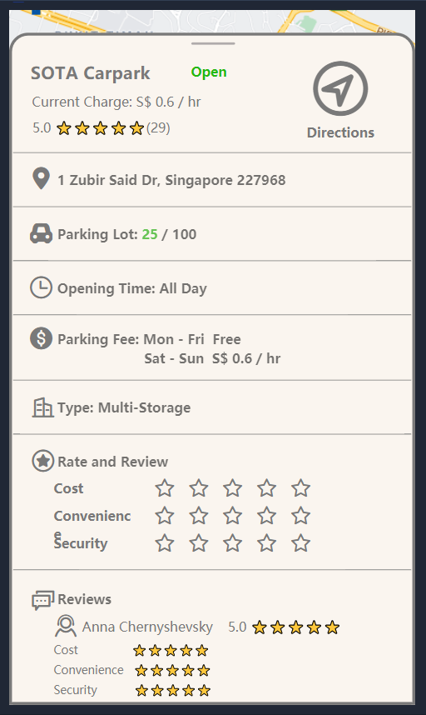
Detailed Carpark Information
Press to navigate the path to the selected carpark via Google Map
Pull down to show the map
Detailed carpark information:
- Full address
- Number of available parking slots
- Total capacity
- Carpark type
- Operating Hours
- Parking Fee for different time slots
- Ratings
Allow user to rate the selected carpark based on the given three aspects

Slide 13
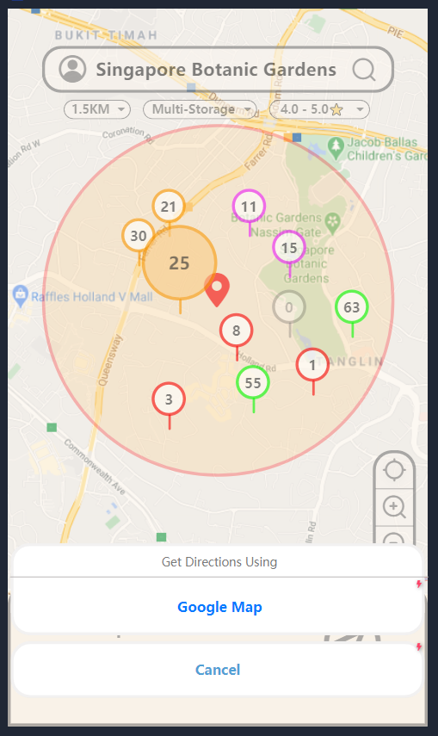
Get Directions
Press to navigate the path to the selected carpark via Google Map
Press to remain in the current page

Slide 14
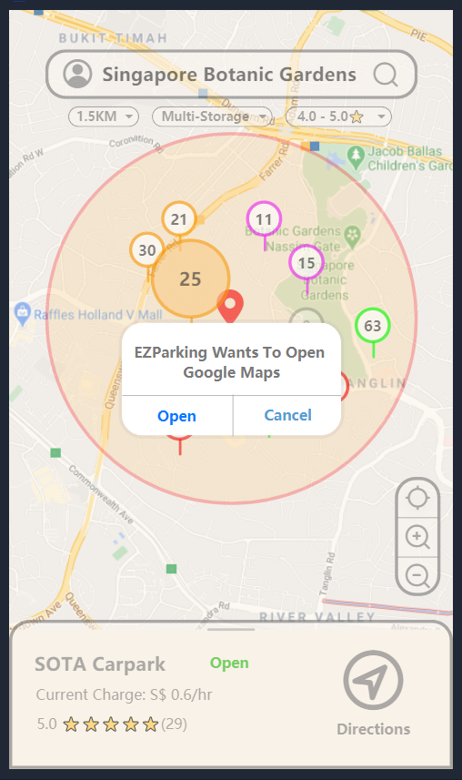
Direct To Google Map
Direct to Google Map for path navigation
Press to remain in the current page

Slide 15
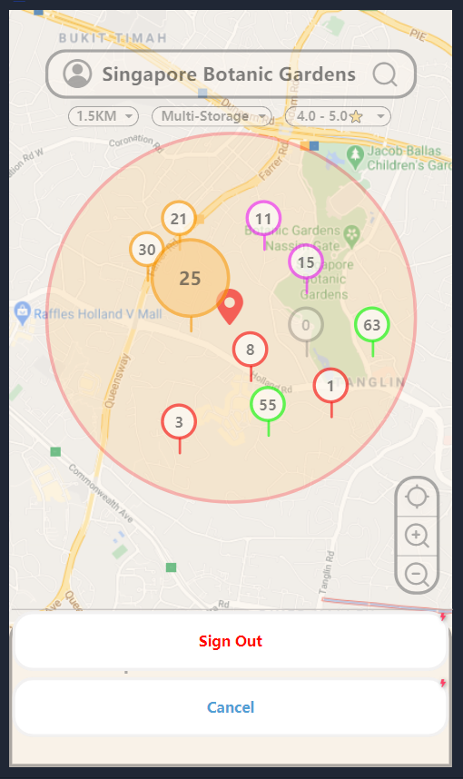
Sign Out page
Press to sign out
Press to remain in the current page

Slide 16
Flow Chart

Slide 17
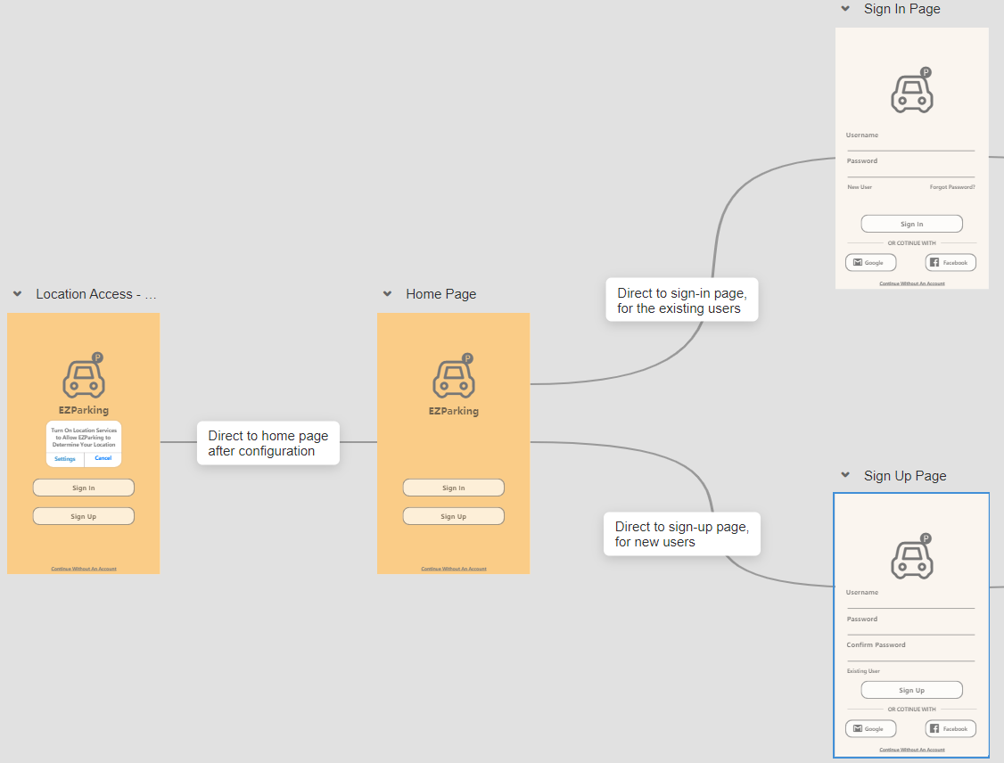

Slide 18
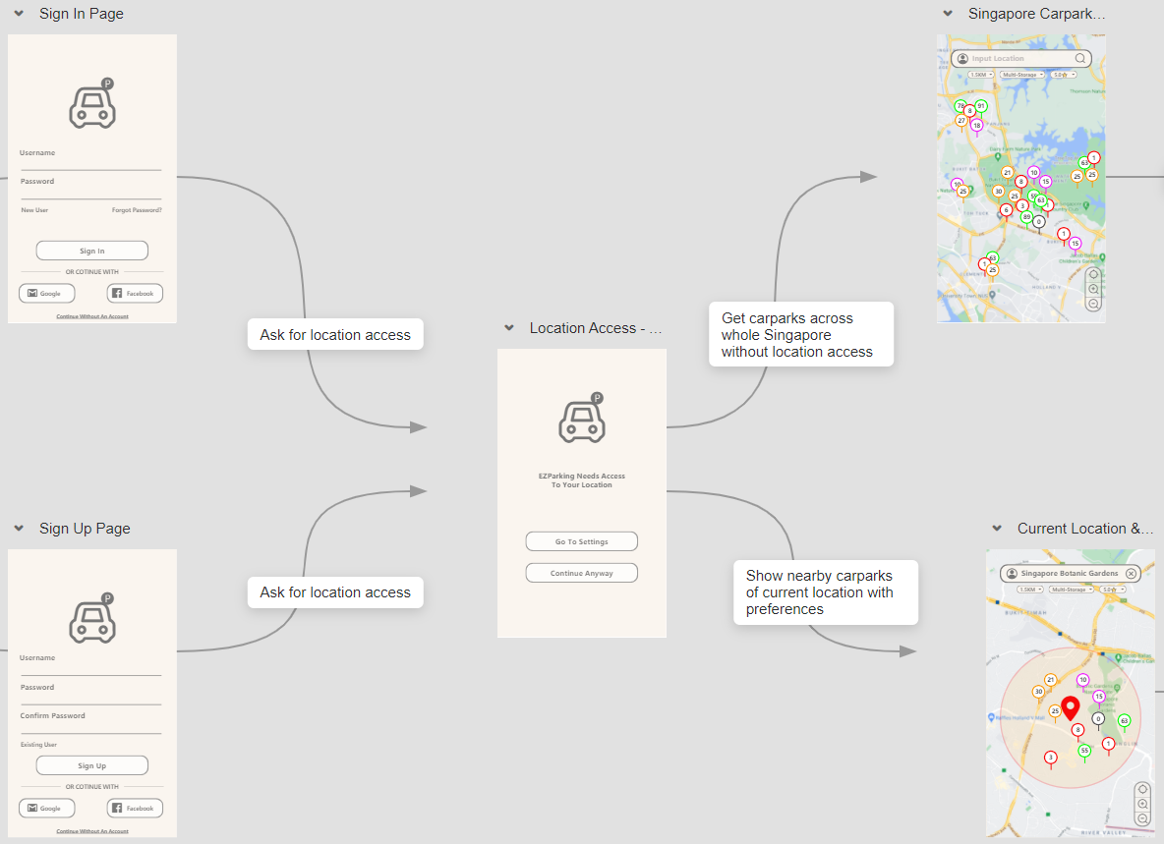

Slide 19
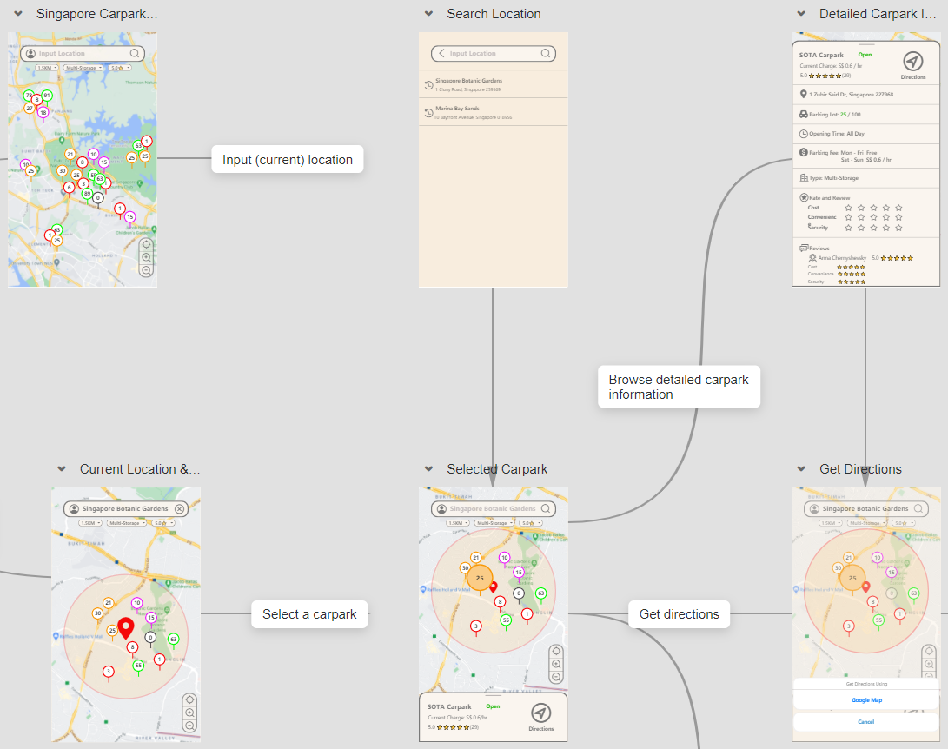

Slide 20
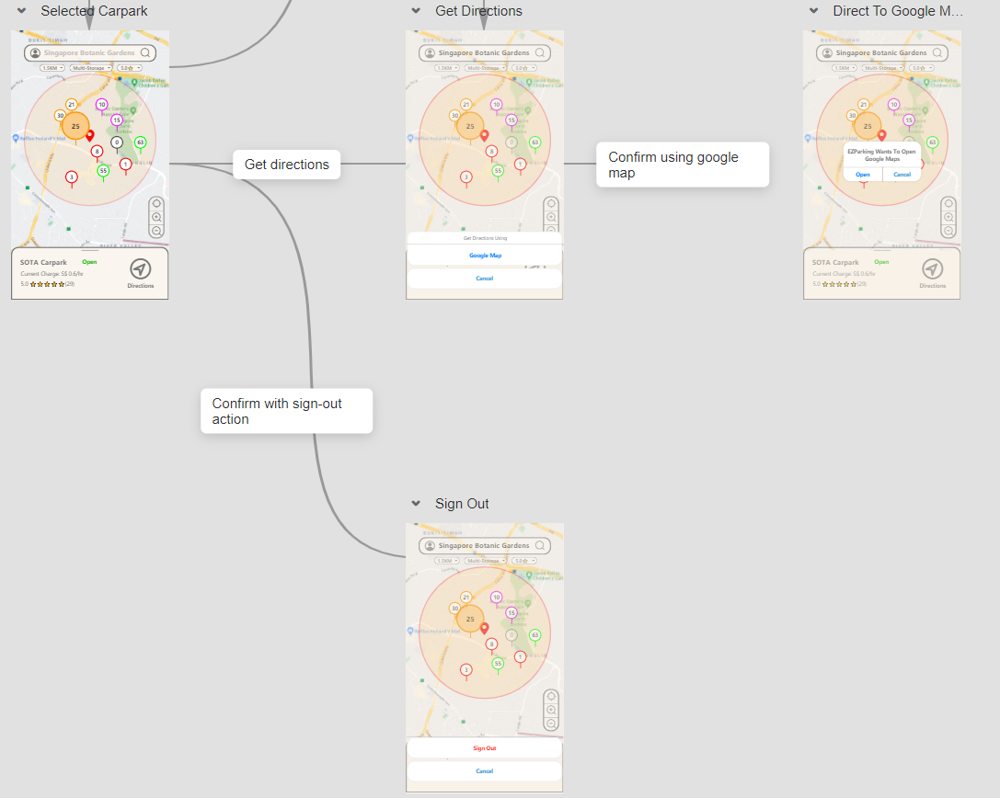

Slide 21
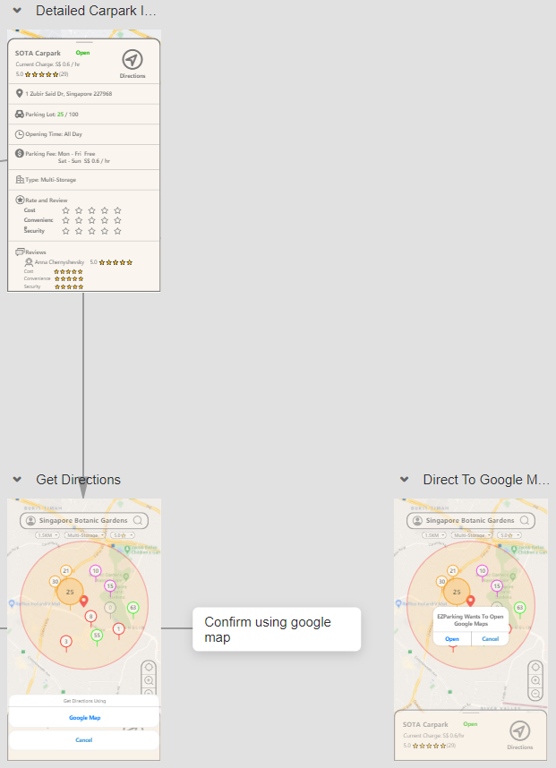

Slide 22
Overview

Slide 23
